Slide 1
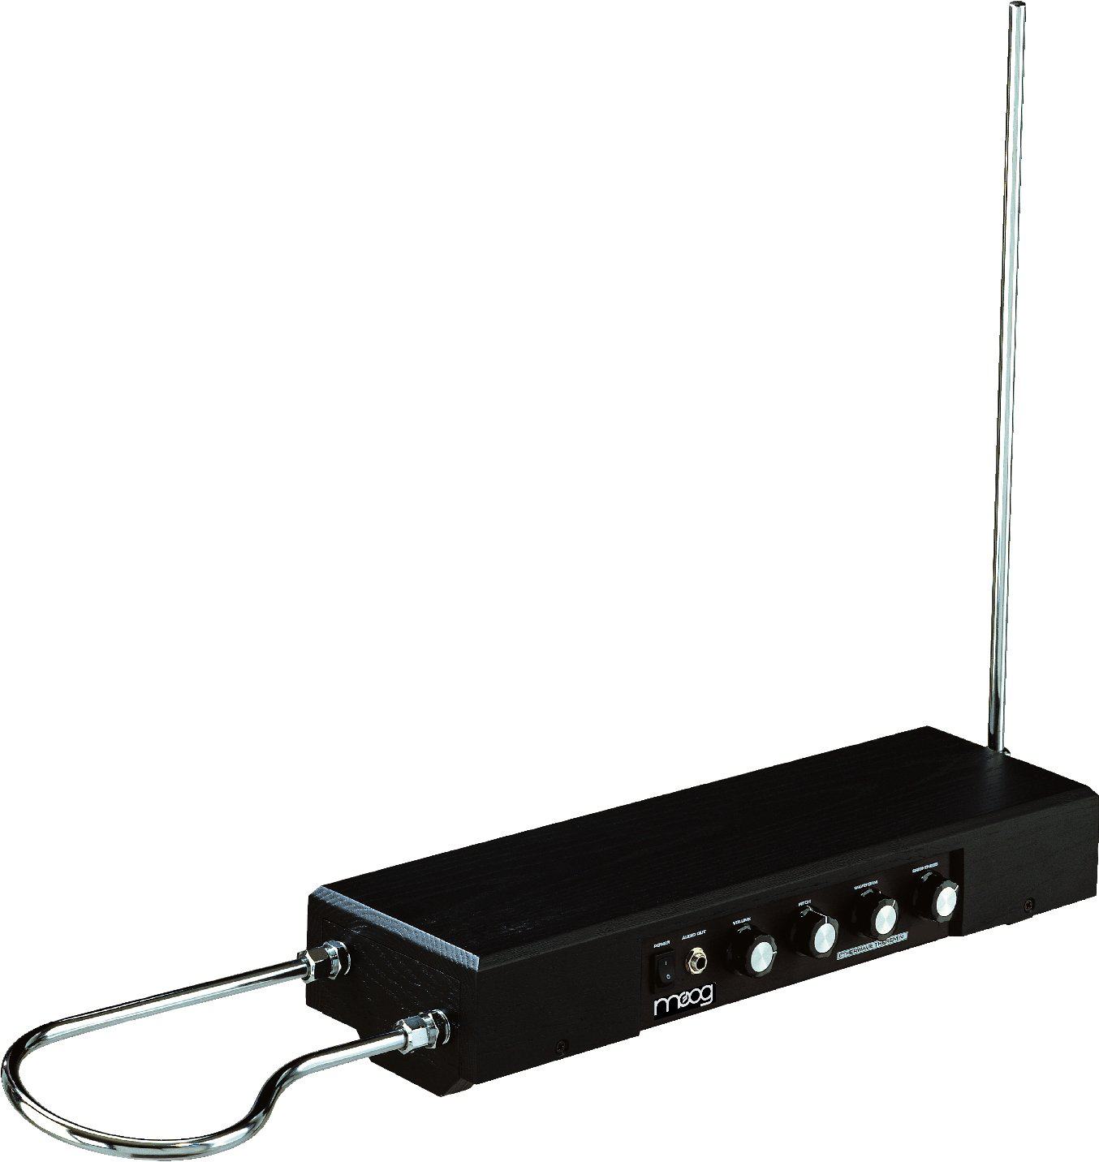
Supervisor: Dr. Y. Singh
Building a Theremin
Tom Bryant and Josh Wainwright

Slide 2
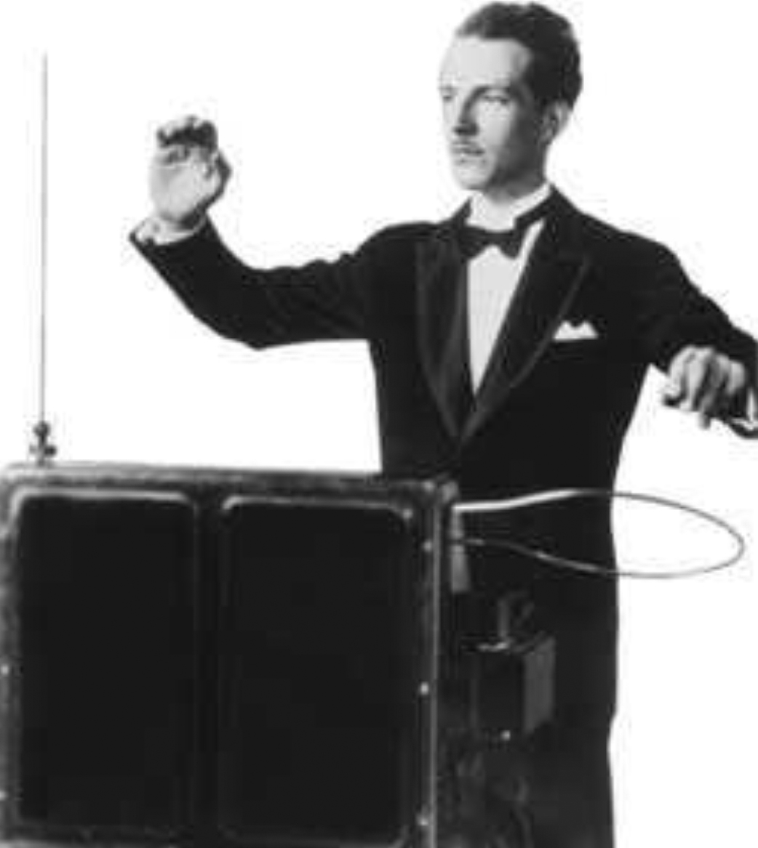
The History of the Theremin
Lev Sergeivich Termen, known in Europe as Leon Theremin
Invented in October 1920
Displayed to Lenin
Toured Europe to showcase the height of Russian technology

Slide 3
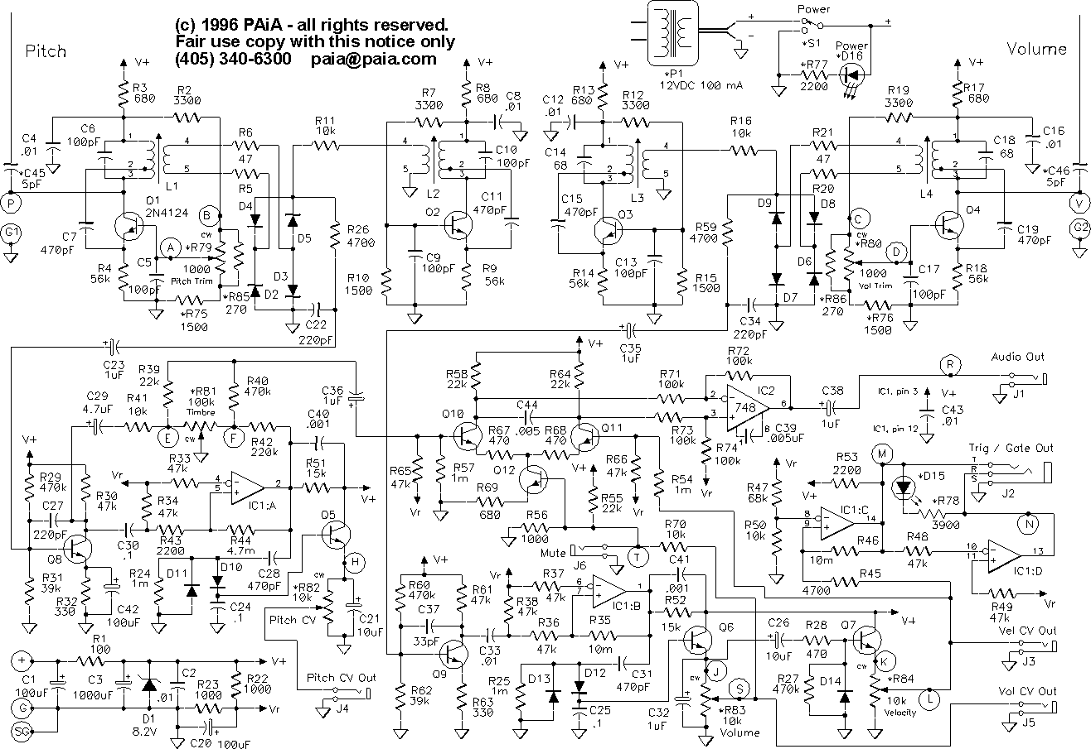
Basic Concept

Slide 4
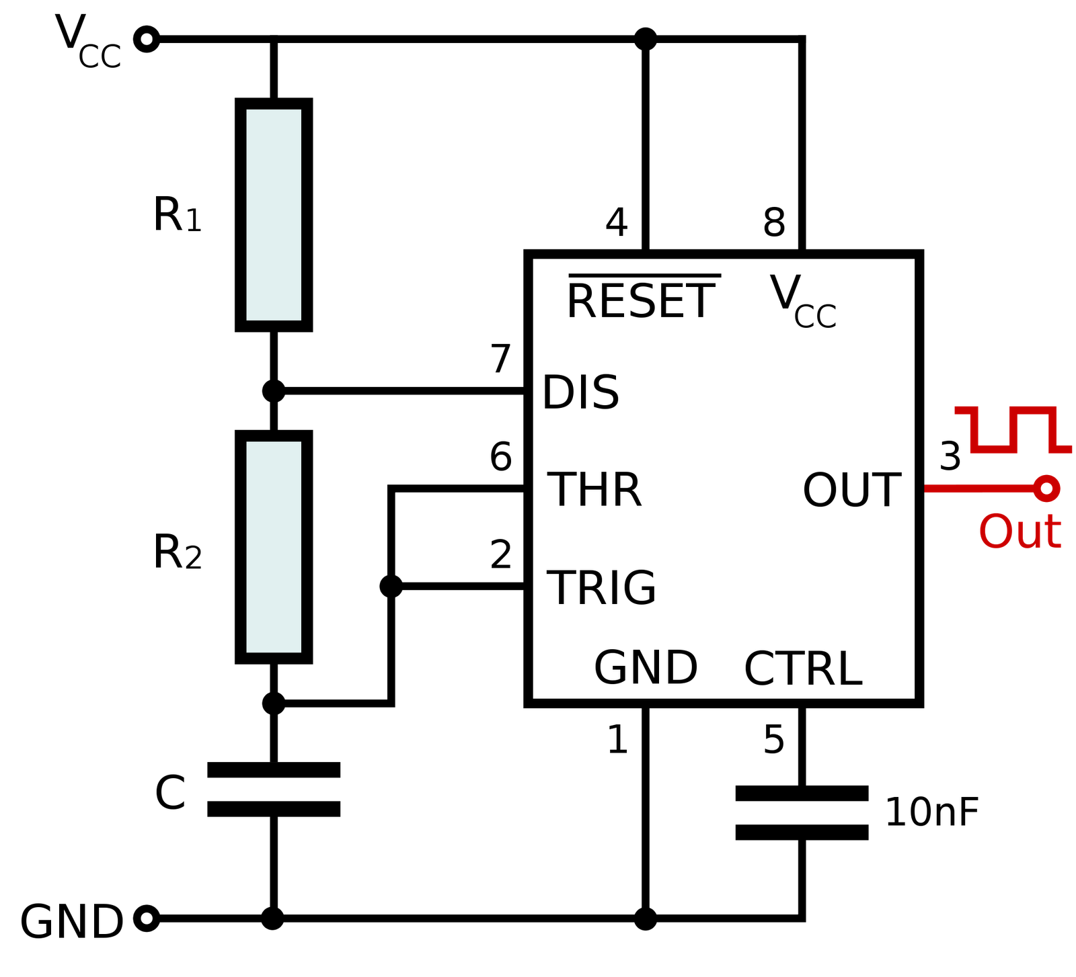
555 IC Timer Circuit

Slide 5
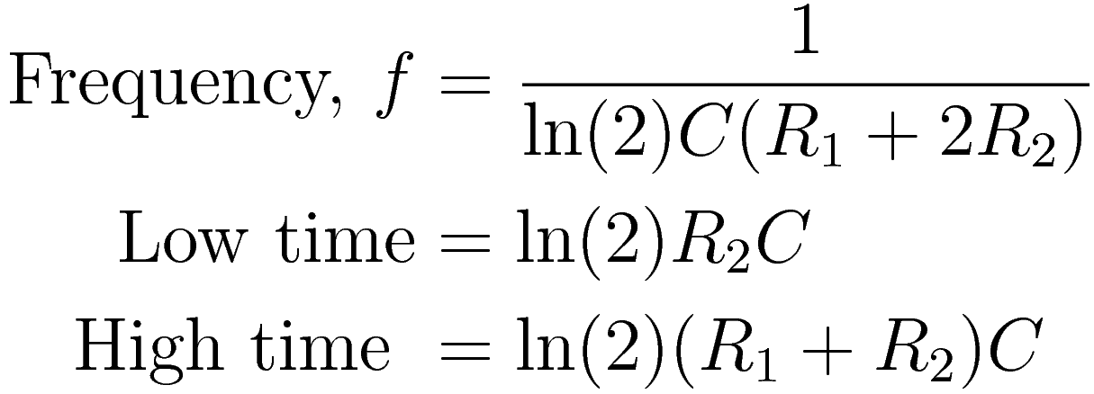
Two 555s

Slide 6
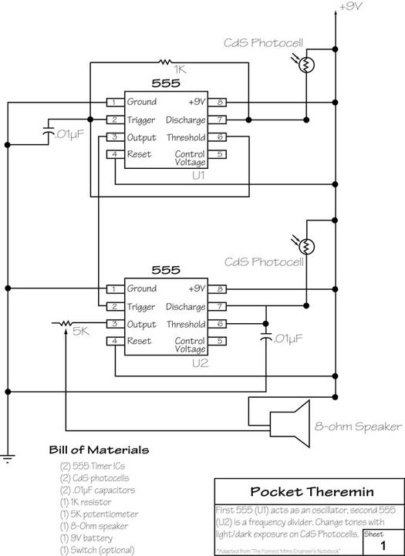
Two 555s
Second 555 chip acts as the volume control
LDRs control the resistances and hence the pitch and volume

Slide 7
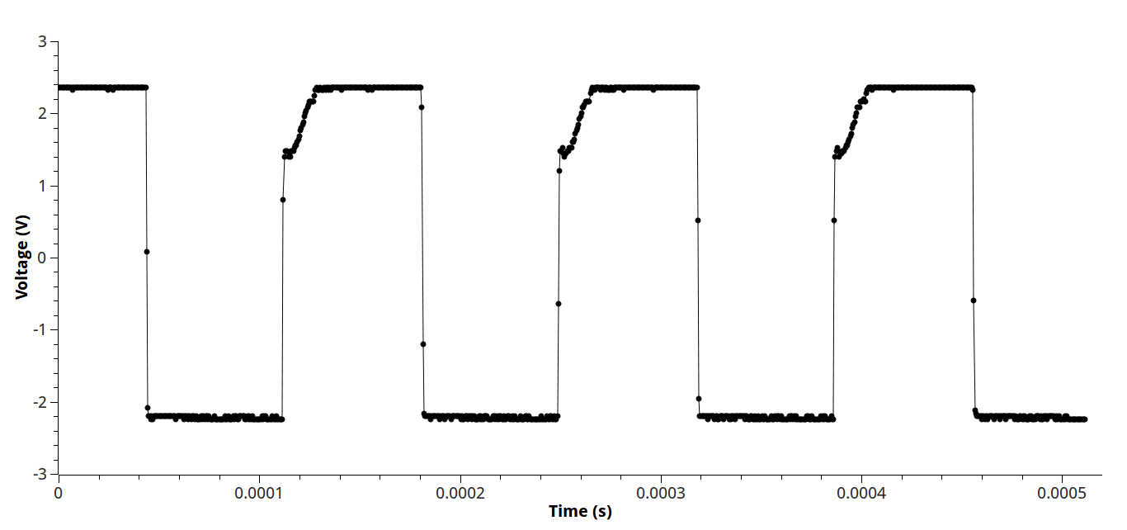
High Frequency

Slide 8
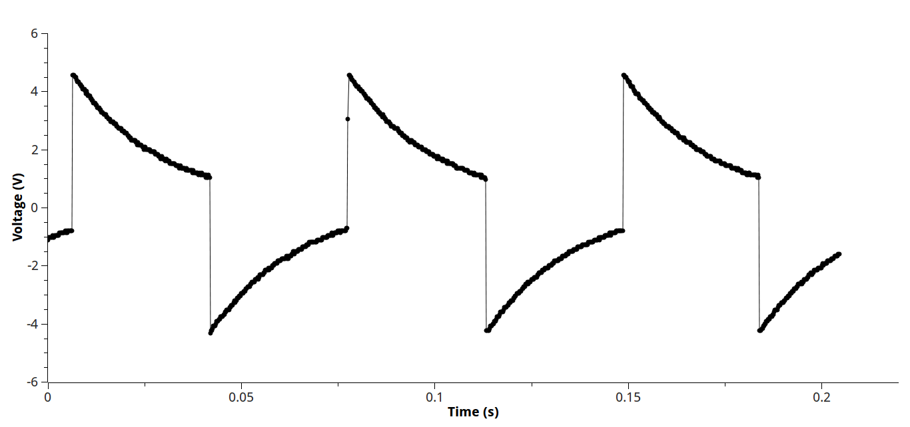
Low Frequency

Slide 9
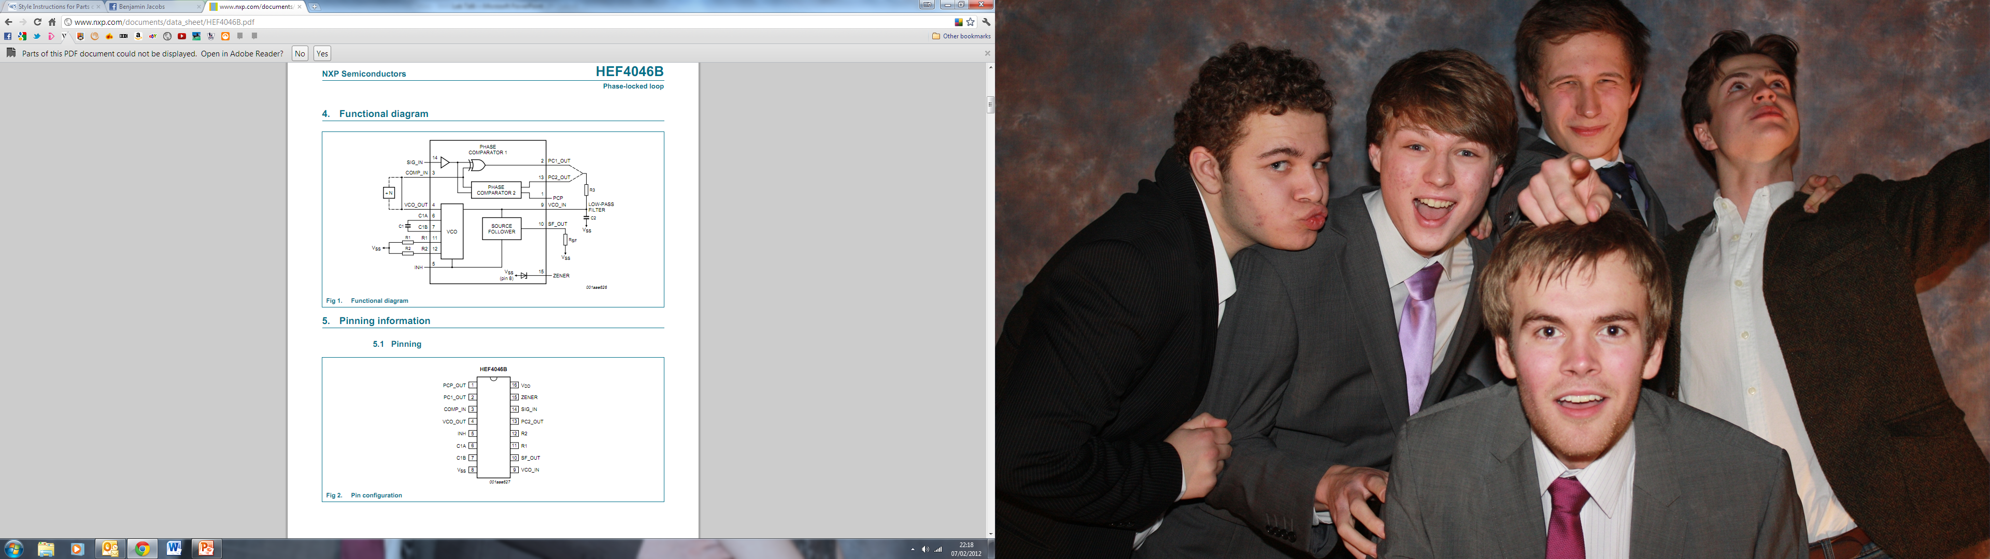
4046 VCO
CMOS Chip
Includes 2 phase comparators, a zener diode, and most importantly a Voltage Controlled Oscillator

Slide 10
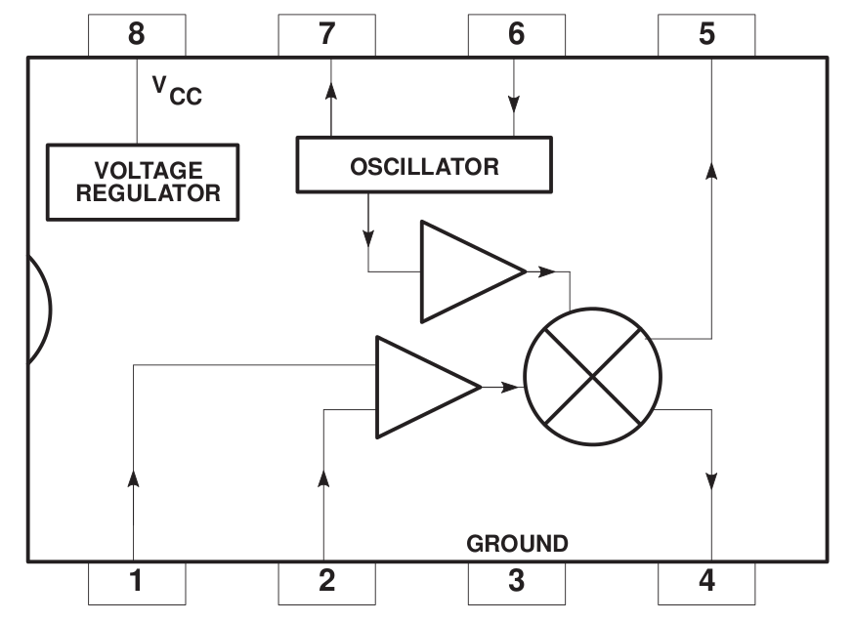
Mixer Circuit

Slide 11
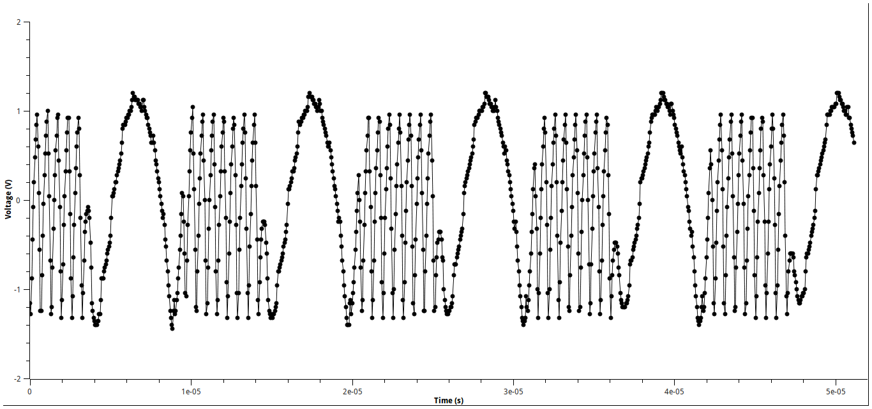
Mixer Signal

Slide 12
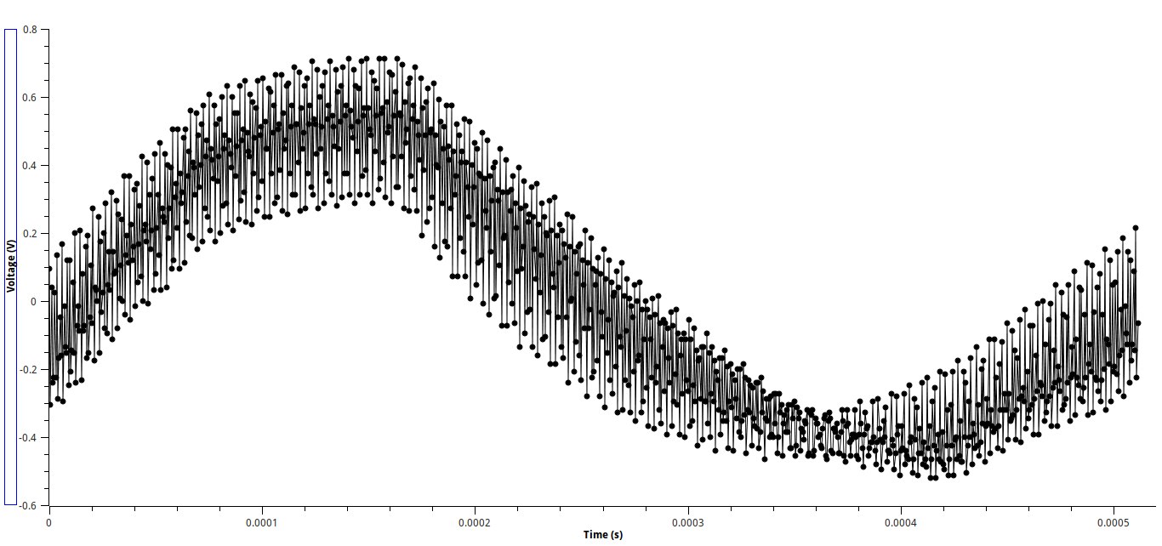
Need for a Low Pass Filter

Slide 13
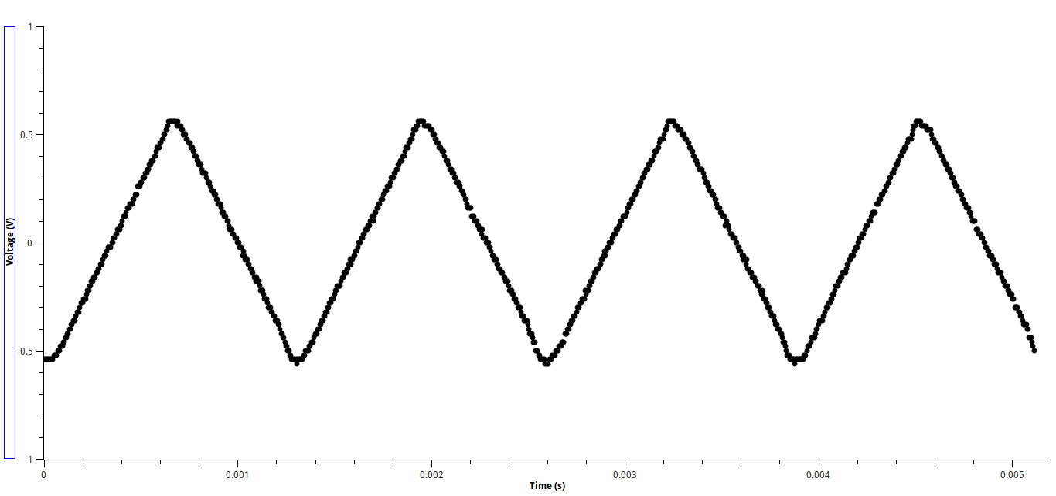
Triangle Wave from Square

Slide 14
555 Again
What if R1=0?

Slide 15
Conclusion – Where are we heading?
Use the 7555 Timer IC to produce oscillator >1MHz?
Build an LRC circuit to produce oscillations?
Use a low pass filter as the input to the 4046 VCO?
Produce a method of volume control

